Slide 1

SPEECH EMOTION RECOGNITION USING LIBROSA
PRESENTERS:
2010030087 PAVAN VIKHYATH
2010030359 VENKATESH
2010030364 YASHWANTH
2010030520 KARTHIK
GUIDE : DR.SREE LAKSHMI

Slide 2
TABLE OF CONTENTS:
ABSTRACT
FLOW CAHRT
GITHUB COMMITS
WORK PROGRESS
ALPHA TESTING
REFRENCES

Slide 3
ABSTRACT:
1.Speech emotion recognition is a technology that extracts emotion features from computer speech signals, compares them, and analyzes the feature parameters and the obtained emotion changes.
2.Recognizing emotions from audio signals requires feature extraction and classifier training.
3.The feature vector is composed of audio signal elements that characterize the specific characteristics of the speaker (such as pitch, volume, energy), which is essential for training the classifier model to accurately recognize specific emotions.
4. Distinct differences are observed in the features for Happy/Anger and Fear, and between Happy and Anger emotions which is otherwise a challenging problem.
5. Librosa is a python package for music and audio analysis. It provides the building blocks necessary to create music information retrieval systems.

Slide 4
SIGNAL
INPUT
FEATURE EXTRACTION
EMOTION RECOGNITION
DIGITAL SIGNAL
FEATURE
RESULTS
THE MODEL OF EMOTION DESCRIPTION
CORPUS
FLOWCHART:

Slide 5
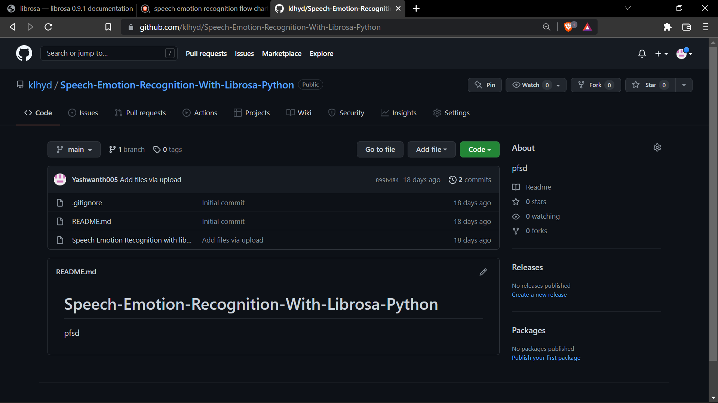
GITHUB COMMITS:

Slide 6
WORK PROGRESS:
We started working on speech emotion recognition using librosa
Got to know more about speech emotion recognition
we are working on errors in code
Completed github commits of project
Working on implementation process

Slide 7
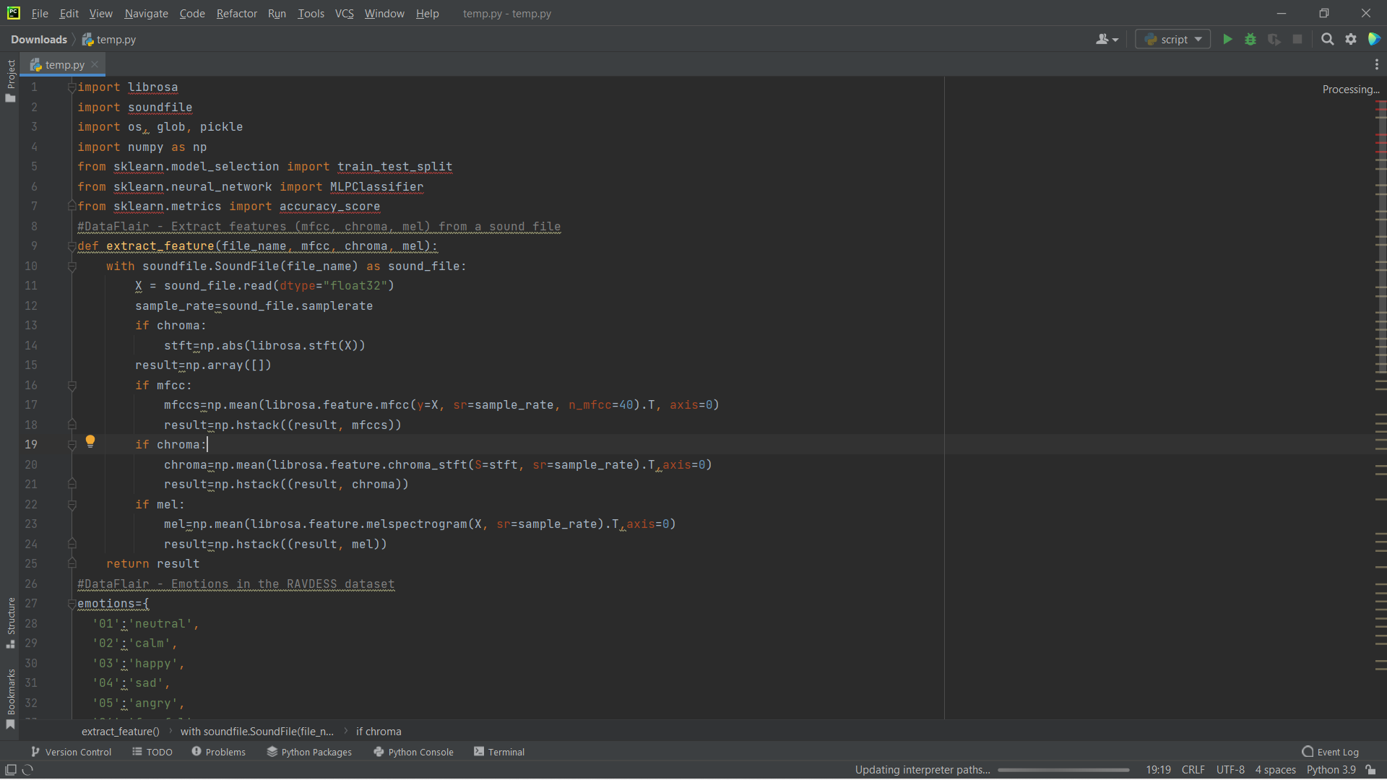
ALpHA TESTING:

Slide 8
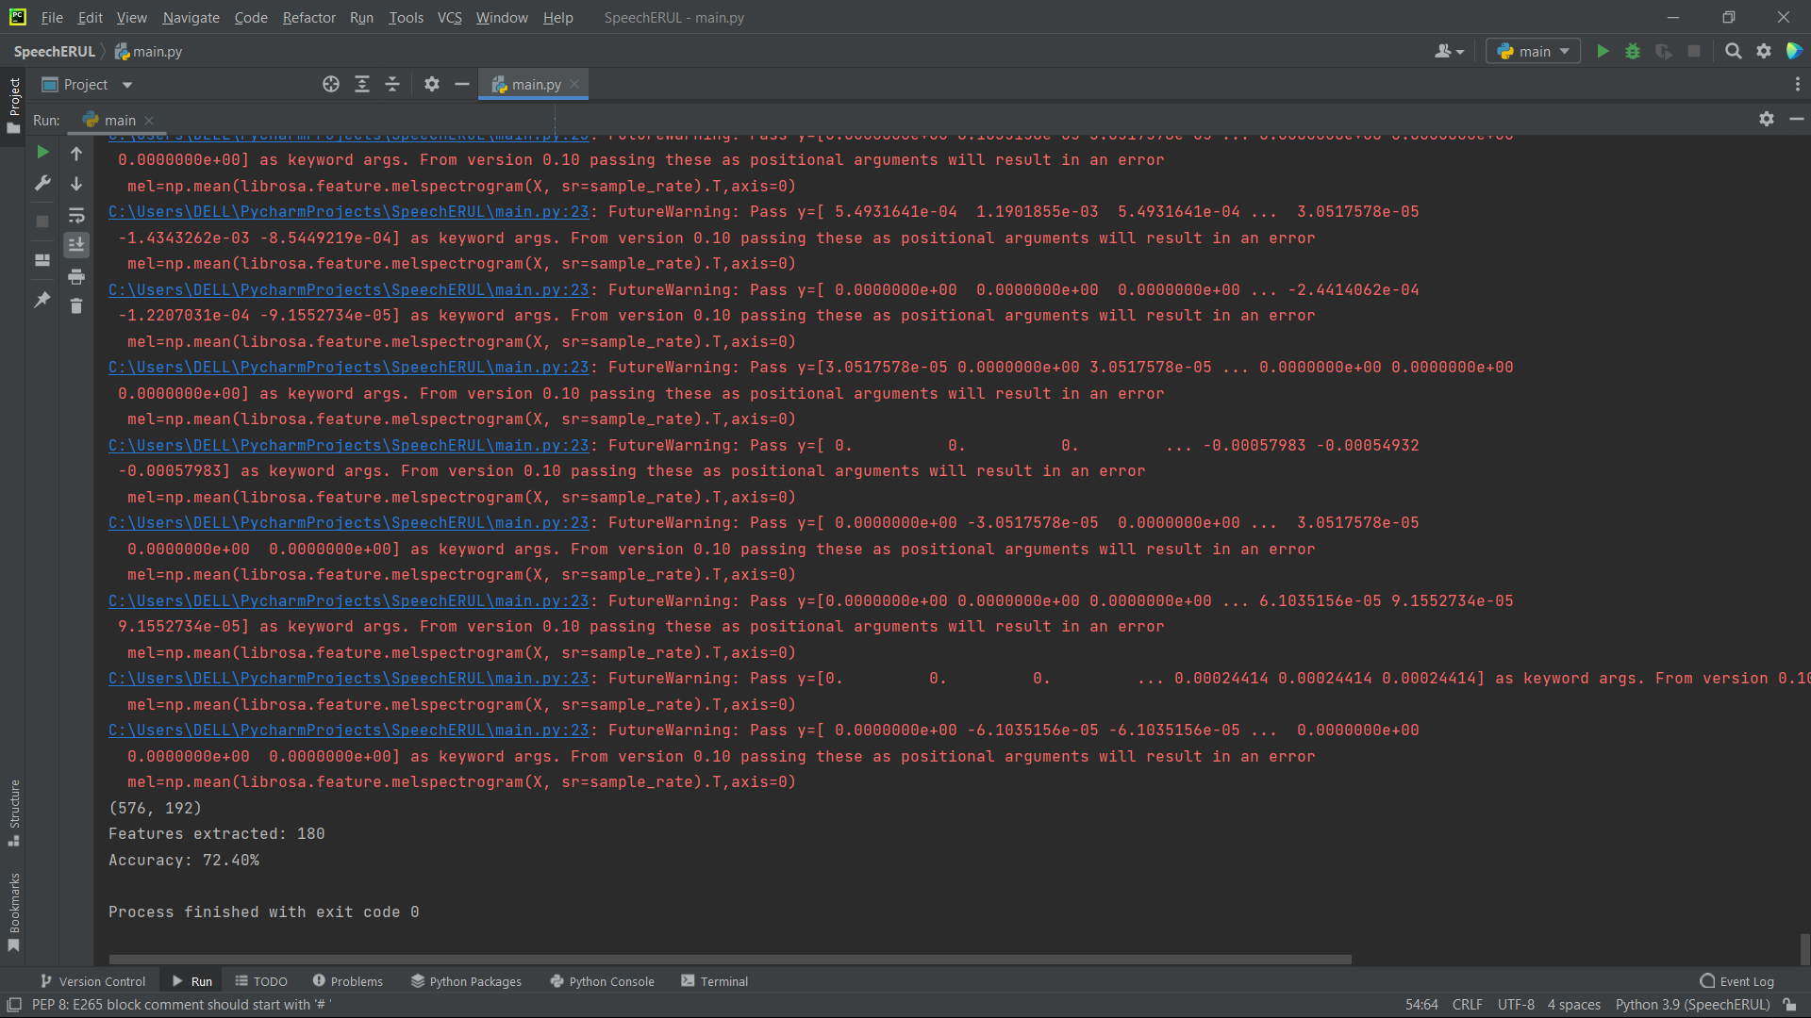

Slide 9
REFRENCES:
1.https://data-flair.training/blogs/python-mini-project-speech-emotion-recognition/
2. https://ieeexplore.ieee.org/abstract/document/9509714/

Slide 10


